Slide 1
Systems Thinking
Exploring Data

Slide 2
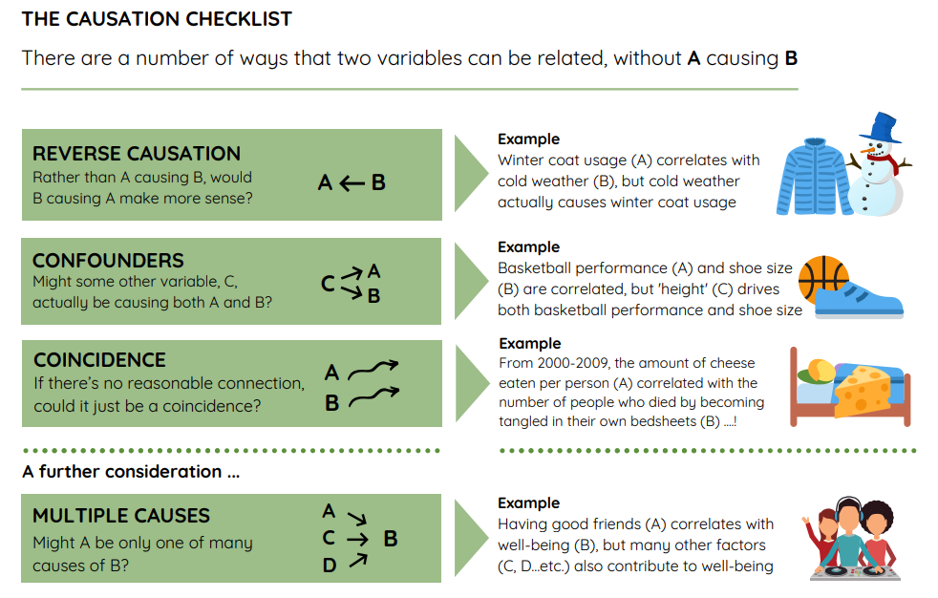

Slide 4
Teacher is boring
I am sleepy

Slide 5
I went to bed late
Teacher is boring
I am sleepy
I just ate lunch

Slide 6
I went to bed late
Teacher is boring
I am sleepy
I just ate lunch

Slide 7
In your groups…
Construct a contingency table for the one explanatory variable associated with your hypothesis.
Analyze your Chi-squared results
p > 0.05: go back to the drawing board
p < 0.05: make it better
Revise your theory:
Consider “multiple causes” but the other explanatory variable must be related to the original
Do more testing
Build additional contingency tables for these other explanatory variables

